Slide 1
Southern Alberta Child and Family Services
Child Intervention Practice
in Alberta – Current and Future Directions

Slide 2
South Region

Slide 3
Amalgamation of Region 1 – Southwest CFS and Region 2 – Southeast CFS
As of January 1, 2014, Southwest Child and Family Services and Southeast Child and Family Services joined together to create one region now known as
Southern Alberta Child and Family Services.
With the joining of these two regions, opportunities to better serve Albertan’s is endless. We are able to combine best practices, review resources and restructure the teams to allow for efficiencies and effective support for our families in the region.

Slide 4
Our Vision Story – The Story of Our Future
The Alberta we envision has secure and resilient people, thriving families, and inclusive communities.
At Human Services, we believe that every Albertan and every family, no matter what their circumstances or abilities, has strengths to draw on and the potential to succeed.
We believe our citizens should be able to find help easily within a person-centred system of high quality services, knowing they’ve come to the right place.

Slide 5
Our story continued…
To make this future real, we partner with communities and service providers to ensure that we deliver the right services at the right time in a way that respects the uniqueness of every child and the dignity of every person.
We are also placing unprecedented emphasis on preventative actions so that new generations of strong, self-reliant Albertans will need fewer interventions in their lives.
We work for Human Services because we want to make a difference in people’s lives. There is nothing more important.

Slide 6
Child Intervention Practice in Alberta
Child intervention practice has evolved as a natural and expected continuation of a commitment to improving outcomes for children and families.
Through practice and evidence, we have learned more about the clients we serve and what works.
Child Intervention practice has become more collaborative, recognizing the critical importance of relationships with families, communities and service delivery partners.
Notes:
Describe evolution: starting with ARM – tenets of differential response, community partnerships, early intervention, family involvement, permanency; CYFEA – embedded tenets into legislation; CWPM: provided the task specific policies & procedures to support the philosophy of the Act, outlined pillars of assessment, engagement and collaboration; OBSD- focused on using the pillars towards defined outcomes for children & families, movement to shared practice & an increased focus on principle based practice as a result - talk about how personal practice principles guide work now – assessment story – investigation vs assessment

Slide 7
Elements of a Practice Framework
Practice frameworks often include five main elements:
The organization’s values, principles, and beliefs.
The organization’s philosophy and approach to support good practice.
A description of the outcomes to be achieved for children and families.
Practice strategies, methods and tools used in service delivery.
Defines how the organization, staff, families, communities, service providers and other stakeholders should work together to ensure the safety, stability, permanency and well- being of children and their families.

Slide 8
Principles

Slide 9
CIPF Principles
Aboriginal Experience
Aboriginal peoples have always had their own ways of ensuring that vulnerable members, including children, are safe, protected and nurtured. We honour this by recognizing their expertise in matters concerning their children, youth and families.
Preserve Family
We believe children and youth should be safe, healthy and live with their families, therefore we focus on preserving and reuniting families and building on the capacity of extended family and communities to support children, youth and families.

Slide 10
CIPF Principles
Strengths-Based
Our approach is reflective, culturally responsive and strengths-based. Because all families have strengths and resources, we recognize and support the right and responsibility of parents to share in the decision-making process for them and their children.
Connection
Children and youth are supported to maintain relationships that are important to them, be connected to their own culture, practice their religious or spiritual beliefs and, for those with involvement, have a plan for their care where they are included in the decision-making process.

Slide 11
CIPF Principles
Collaboration
We are child-focused and family centered. We collaborate with families, community agencies, and other stakeholders in building positive, respectful partnerships across integrated multidisciplinary teams and providing individualized, flexible and timely services to support these efforts.
Continuous Improvement
Our casework is transparent and we share information appropriately. Our approach is outcome-oriented and evidence-based therefore we support innovative practice, evaluate our performance and strive for continuous improvement.

Slide 12
Outcomes for Children and Youth
Vulnerable children live successfully in the community
Children in temporary care are reunited quickly with their family
Children in permanent care are placed in permanent homes as quickly as possible
Youth transition to adulthood successfully
Aboriginal children live in culturally appropriate placements

Slide 13
Changes in Practice
Connections with our Aboriginal partners are being strengthened
Family meetings are being encouraged as families have the responsibility and right to participate in decisions and plans that affect them
Unique individualized plans are being developed and supported
Through the provision of early intervention and prevention services, children, youth and families are better able to address issues earlier on at a community level
Notes:
Front end
Piloted in CFSAs and DFNAs
Supports staff in critical thinking and intentional practice to ensure that children and families are provided the right services at the right times to support them in reaching their goals.
Infusing principle-based practice with families at initial intervention contact (“front end”).
Balancing the strengths of a family, protective factors, and an understanding of risk.
Practice Strategies
Reinforce the collaboration between the CFS’s and the DFNA’s starting at the assessment process and throughout the life of the file
Taking more time to engage the family in both the information gathering and planning process
Encouraging participation from extended family, formal and informal supports who can contribute and be a part of the family’s safety plan
Focusing on the strengths of the family that support safety
SOS
A strengths-based, safety-organized approach to child protection casework.
Developed by Andrew Turnell and Steve Edwards in Western Australia in 1990 using techniques from solution-focused brief therapy.
Designed to create a shared focus and help everyone think their way into and through the case.
Aims to work collaboratively with all people involved in a case to assess and plan for increasing safety and reducing risk and danger by focusing on a family’s strengths, resources and networks.

Slide 14
What has worked well?
Families are more engaged - reduces anxiety.
Parents have confidence and the capacity to take ownership and implement own plans when viewed as experts.
Workers have confidence that children can be kept safe at home.
Assumptions about what is harming the child and what is safe enough are challenged.
Workers and families build a joint understanding of concerns.
Assessment process is less reactive and considers everyone’s perspective.
There is shift from managing risk to building safety.

Slide 15
Mapping Our Journey
Partnership between:
Piikani Child and Family Services
Kainaiwa Children’s Services
Southern Alberta Child and Family Services
“ak koh ka noat tah ka yop”
“We will all come home”

Slide 16
An Overview of our Journey Together

Slide 17
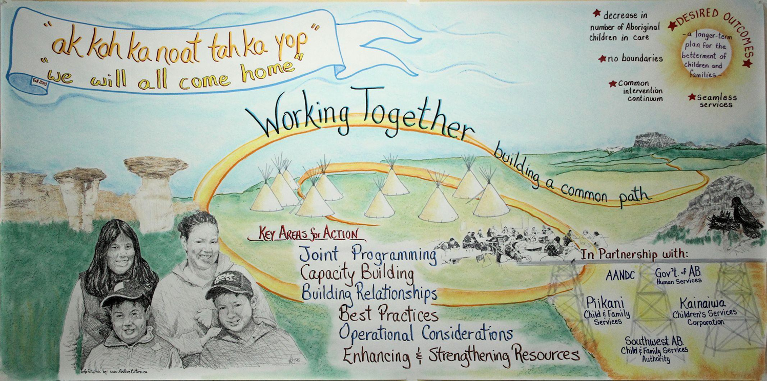
Inspirational Graphic Facilitators unveiled a mural capturing highlights of the work of this group entitled, ‘Ak koh ka noat tah ka yop’ or ‘We will all come home’
Southern Alberta child and Family Services, Piikani Child and Family Services & Kainaiwa Children’s Services have established a solid partnership to help strengthen cultural understanding, creating and sharing opportunities for the betterment of all children, youth and families in Southern Alberta

Slide 18
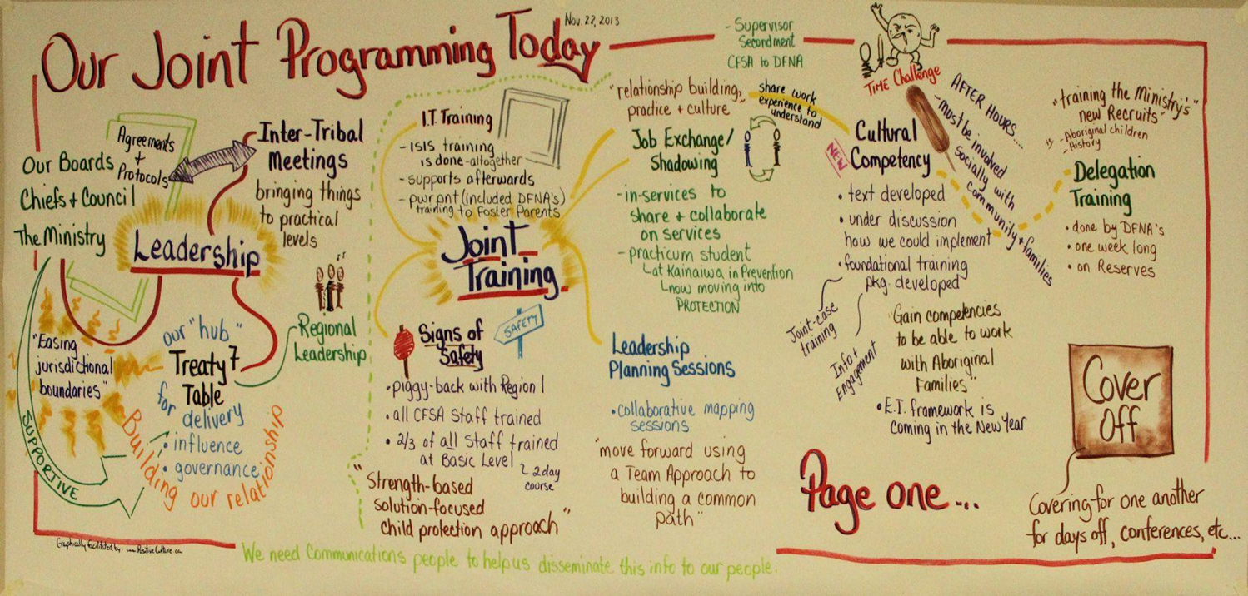
Shared understanding mapping our joint programming of today…..
Our Goals are to:
Establish a solid foundation for partnership
Shift the paradigm from protection to prevention
Create a collaborative environment
Build a relationship with the community
Build a relationship to form a team

Slide 19
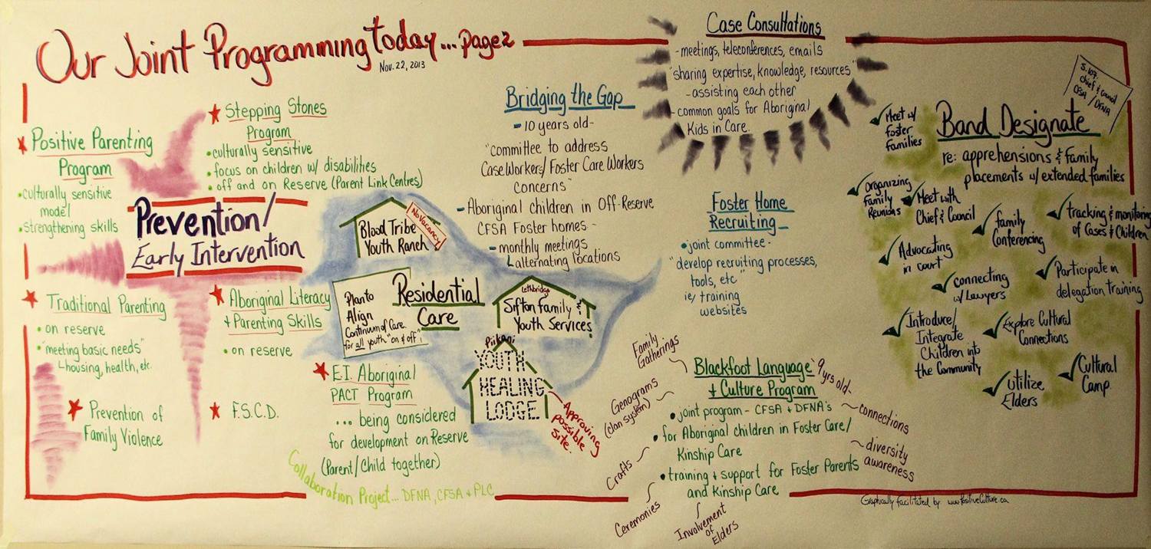
Shared understanding mapping our joint programming of today...(con’t)
Mission
To work as a unified team through embracing the uniqueness of other in order to promote and maintain healthy, trusting relationships

Slide 20
Southern Alberta Health Wellness and Excellence Plan
Staff and Culture
Succession planning
Training
Administrative Support
Orientation
Specialist Roles

Slide 21
Southern Alberta Health Wellness and Excellence Plan
Practice Strategies
Signs of Safety
Outcomes Based Delivery Service (OBSD)
Fetal Alcohol Spectrum Disorder (FASD) – Community of Practice
Cultural Competency
Cultural Connections
Youth Strategies
Family Meetings
Kinship First
Advanced Intake

Slide 22
Thank you for your ongoing support!

