Slide 1
Improving Child Intervention Practice
Signs of Safety
Barb Lacroix
Child Intervention Practice Specialist
Notes:
Introduce self and role as CI Practice Specialist
Brief overview of Signs of Safety
Janice Haddow will walk you through a case example from Old’s Alberta

Slide 2
Signs of Safety
What is Signs of Safety (SOS)?
A strengths-based, safety-organized approach to child protection casework.
Developed by Andrew Turnell and Steve Edwards in Western Australia in 1990 using techniques from strengths based, solution-focused brief therapy techniques.
Aims to work collaboratively with all people involved in a case to assess and plan for increasing safety and reducing risk and danger by focusing on strengths, resources and networks the family have.
Notes:
Andrew Turnell was a therapist practicing Solution Focused Brief Therapy
Steve Edwards was a Child Protection Worker – found that
Went to 100 families what were the tools and techniques that they were using that were working.
Being used in over 200 jurisdictions world wide. Carver County and Olmstead in the USA have been using Signs of Safety the longest which has been about 9 years and Western Australia has been fully implemented for about 5 years now.
With Signs of Safety - it aims to work collaboratively with all people involved in the case plan to increase safety and reduce risk. It is not just the professionals of the CI worker working on their own or coming up with a plan and telling the family what they need to do. Because that is what we have done traditionally which is the medical model or paternalistic.
Secrecy is the syndrome of child abuse”
Andrew Turnell
How do we break the secrecy of child abuse?
Best predictor of future danger is past harm.
How do we talk about child abuse?
Openly, using child’s words to help their parents understand impact which will hopefully lead to change and building child safety.

Slide 3
Three Core Principles of the SoS Approach
SoS seeks to address child abuse and maltreatment through 3 core principles:
Establishing constructive working relationships and partnerships between professionals and family members.
Engaging in critical thinking and maintaining a position of inquiry.
Staying grounded in the everyday work of child protection workers
Notes:
Involving the family along with their informal and formal supports right from the beginning
Asking questions of families, ourselves, and of others involved. We don’t form an opinion and keep that opinion, we have to be willing to look at new inforamtion. Irene Munroe – a leading expert in Child Intervention says.– “The way to minimize errors in child intervention, is to admit that we might be wrong.”
SOS Rumors – SOS means we don’t aprehend. SOS means that we try to build safety within the family and if we can not, then children will continue to come into care and in some cases we will continue to seek PGO for children. We are not going to leave children in unsafe situations.

Slide 4
Mapping
One of the biggest problems in child protection is everyone speaks a different language.
We need to build a joint understanding of the situation causing harm and what needs to happen to build child safety.
This process is called “mapping” the case.
The map is a mechanism to arrive at a destination – that destination is rigorous, sustainable everyday child safety in the child’s home.
Mapping uses the language of the family; language understood by the youngest child involved.
Notes:
Everyone speaks a different language – terms like domestic violence (what does that mean?) does that mean a verbal argument, that someone was trying to stab somebody? Addiction – does that mean that people are drinking on the weekend to the point of intoxication or does that mean you are drinking everyday. We want to get behaviorally specific and use that language of the youngest child in the family.
Through SOS we use a process called mapping to be very clear about what we are worried about and what needs to happen.

Slide 5
Four Domains for Inquiry in Signs of Safety
What are we worried about?
Harm Statements
Danger Statements
Complicating Factors
What is working well (existing strength and safety)?
What needs to happen (future safety/ next steps)?
Where are we on a scale of 0 to 10?
10 means there is enough safety to close the case and 0 means it is certain the child will be abused
0---------------------------------------------------------------------10
Danger Statement Safety Goal
Notes:
Harm
Has already happened (past harm)
Caregiver behavior and it’s impact on the child
We need behavioral detail (what you would see in detail and must describe it in detail) and how it impacted the child (needs to include the date if possible)
harm statements should include S (severity – how bad), I (incidents – how often), and I (affect on child or impact on child)
Use family language rather than professional language
Danger
Future Danger what we are worried about and what others are worried about
Past incidents predict future danger
What would happen if we didn’t do anything or nothing changes
Danger statements need to reflect the harm that is likely to happen to the children if nothing changes
Danger statements should not be catastrophic but not minimize the danger either
If CFSA does not have a danger statement then there should not be an open file
Use family language that a child would understand

Slide 6
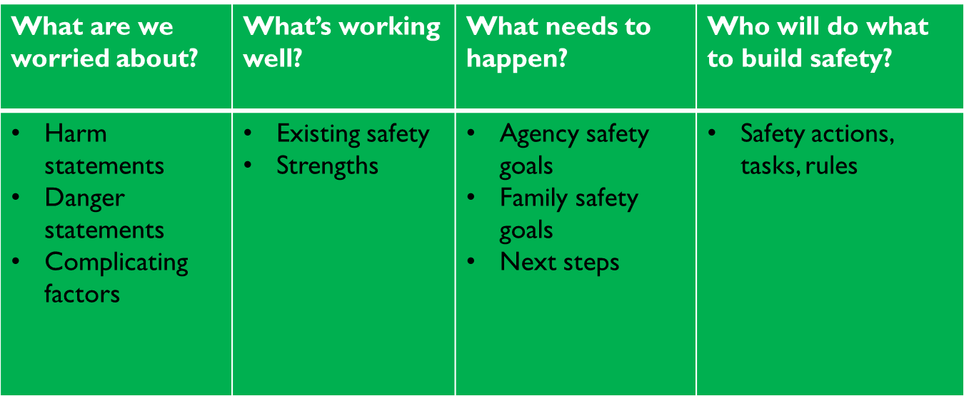
Signs of Safety
Mapping is Critical Thinking
How worried are we?
A judgment about risk using the Safety Scale
0------------------------------------------------------------------------------------------10

Slide 7
Involving Children in Signs of Safety
Children involved in child intervention have reported they feel like “pawns in big people’s games” and they have little say or contribution in what happens to them.
http://www.youtube.com/watch?v=tkxvlq25Kqw
Primary reason is lack of straight forward tools and practical guidance.
SoS uses straight forward tools to work with children: Three Houses, Wizards and Fairies, Safety House, Words and Pictures, etc.

Slide 8
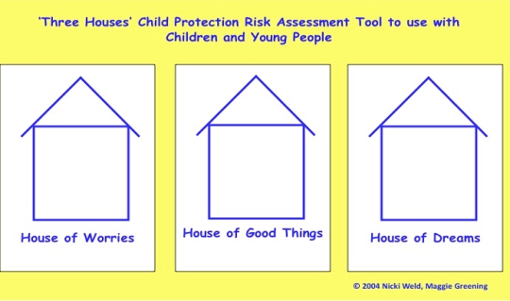
Notes:
Three column conversation with the child
It starts talking about the secret

Slide 11
Words and Pictures Explanation and Child Relevant Safety Plans
“Words and pictures” is a process for informing young children about child protection concerns and a safety planning method that both involves and directly speaks to children.
This is done without trivializing or minimizing the seriousness of the child protection concerns.
It gives everyone working with the child a common language when talking to the child
Notes:
even articulate “unsafe” that well.

Slide 12
Benefits of Words and Pictures for the Caregiver
Allows them to see the strengths of the family and can use positives from the story to build their relationship with the child and the family
Gives them a clear picture of the reason for the child’s placement and is tool they can use when the child has questions
Can help support reunification by discussing the safety plan with the child if they are expressing worries
Notes:
Numerous benefits:
1 – Helps create the safety plan
2 – Explains to the child what happened to them
3 – Helps the child process the trauma and understand why they may be in care
4 – Very impactful for parents
5 – Impactful to the safety network

Slide 13
Safety Planning in Signs of Safety
Safety is strengths demonstrated as protection over time.
Organizing a network (village) that surrounds the child with a common understanding of the concern and specific roles for protection.
A service plan or services are NOT a safety plan. A safety plan is a specific set of rules and arrangements that describe how the family will go about everyday life and show that the children will be safe.
Notes:
Must be developed with everyone involved
Identify the safety goal
Use bottom lines – how we are holding people accountable and how we will achieve the goal
The steps the family will take to reach the safety goal of keeping their children safe
Safety House - Is a words and pictures of the safety plan for the child
Allows child’s voice to the safety plan

Slide 14
You Might See Workers:
Taking more time to engage the family in both the information gathering and planning process
Encouraging participation from extended family, formal and informal supports who can contribute and be a part of the family’s safety plan
Focusing on the strengths of the family that support safety
Workers asking different types of questions geared more toward the strengths of a family

Slide 15
What do these shifts mean to caregiver?
You may be asked to support a family in a new and different way
You may be invited to a family meeting to participation in the ongoing safety planning for the children with their family
Actively participate and collaborate on the development of a service plan designed to achieve intended outcomes

Slide 16
What has worked well?
Families more engaged.
When parents are viewed as the experts it builds confidence and capacity in them to take ownership and implement THEIR plans.
Workers growing in confidence that children can be kept safe in the home.
We are challenging our assumptions and becoming more clear on what is harming the child and what is safe enough. Workers and families build a joint understanding of the concerns.
Assessment process is less reactive and considers everyone’s perspective.
Everyone is on the same page.
Shift from managing risk to building safety – reduces anxiety.

Slide 17
Our Practice Then vs Signs of Safety Now
Then | Signs of Safety
Medical Model Approach Underdeveloped support networks Case consultation is a think tank and attempts to “solve” the case and makes judgments on risk Professionally driven service plan focused on experts and professional services | Family driven solution focus approach Support networks and family are openly talking about the abuse and solutions We discuss acts of protection, over time, that relate to the danger to the child Use questions that result in conversations that help everyone think through the case and scale the level of risk

Slide 18
