Slide 1
Improving Child Intervention Practice
Signs of Safety
Toni Morkin, Senior Manager

Slide 2
Signs of Safety
What is Signs of Safety (SOS)?
A strengths-based, safety-organized approach to child protection casework.
Developed by Andrew Turnell and Steve Edwards in Western Australia in 1990 using techniques from strengths based, solution-focused brief therapy techniques.
Aims to work collaboratively with all people involved in a case to assess and plan for increasing safety and reducing risk and danger by focusing on strengths, resources and networks the family have.

Slide 3
Three Core Principles of the SoS Approach
SoS seeks to address child abuse and maltreatment through 3 core principles:
Establishing constructive working relationships and partnerships between professionals and family members.
Engaging in critical thinking and maintaining a position of inquiry.
Staying grounded in the everyday work of child protection workers

Slide 4
Mapping
One of the biggest problems in child protection is everyone speaks a different language.
We need to build a joint understanding of the situation causing harm and what needs to happen to build child safety.
This process is called “mapping” the case.
The map is a mechanism to arrive at a destination – that destination is rigorous, sustainable everyday child safety in the child’s home.
Mapping uses the language of the family; language understood by the youngest child involved.

Slide 5
Four Domains for Inquiry in Signs of Safety
What are we worried about?
Harm Statements
Danger Statements
Complicating Factors
What is working well (existing strength and safety)?
What needs to happen (future safety/ next steps)?
Where are we on a scale of 0 to 10?
10 means there is enough safety to close the case and 0 means it is certain the child will be abused
0---------------------------------------------------------------------10
Danger Statement Safety Goal

Slide 6
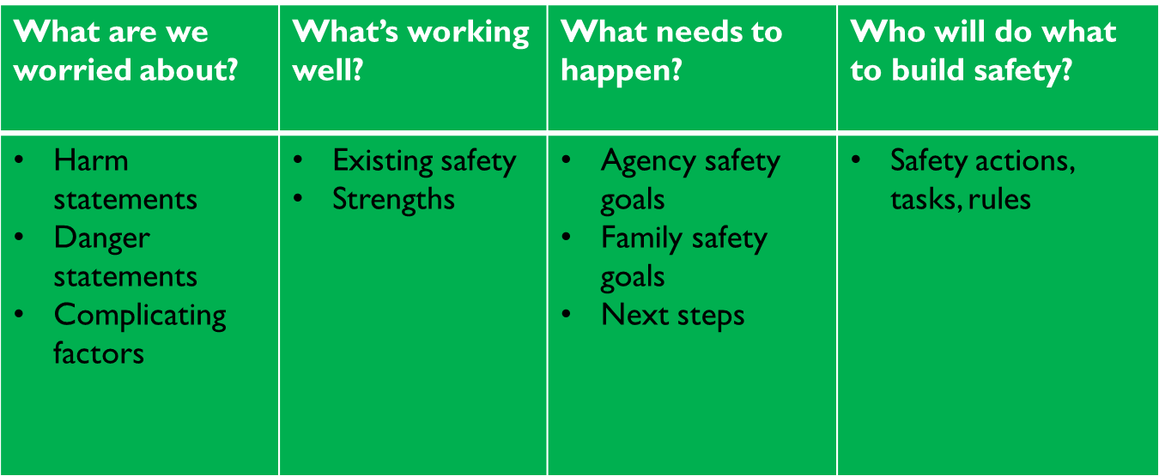
Signs of Safety
Mapping is Critical Thinking
How worried are we?
A judgment about risk using the Safety Scale
0------------------------------------------------------------------------------------------10

Slide 7
Involving Children in Signs of Safety
Children involved in child intervention have reported they feel like “pawns in big people’s games” and they have little say or contribution in what happens to them.
http://www.youtube.com/watch?v=tkxvlq25Kqw
Primary reason is lack of straight forward tools and practical guidance.
SoS uses straight forward tools to work with children: Three Houses, Wizards and Fairies, Safety House, Words and Pictures, etc.

Slide 8
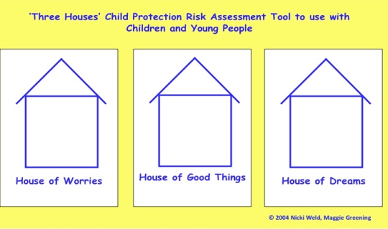

Slide 9
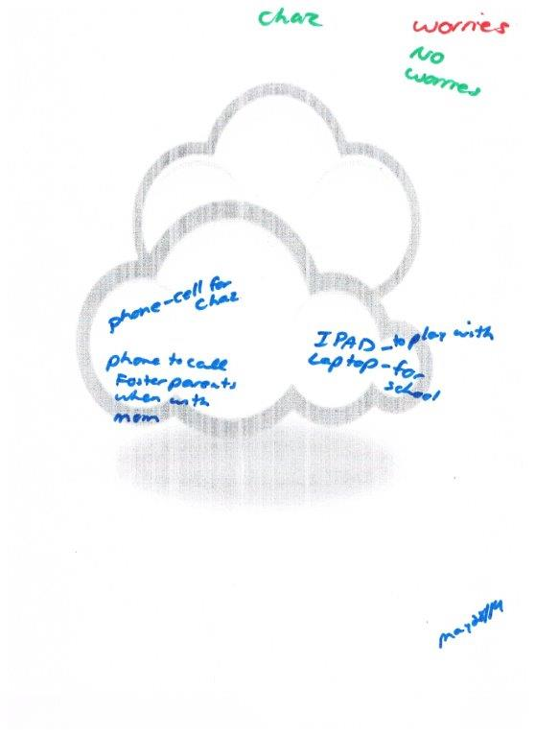
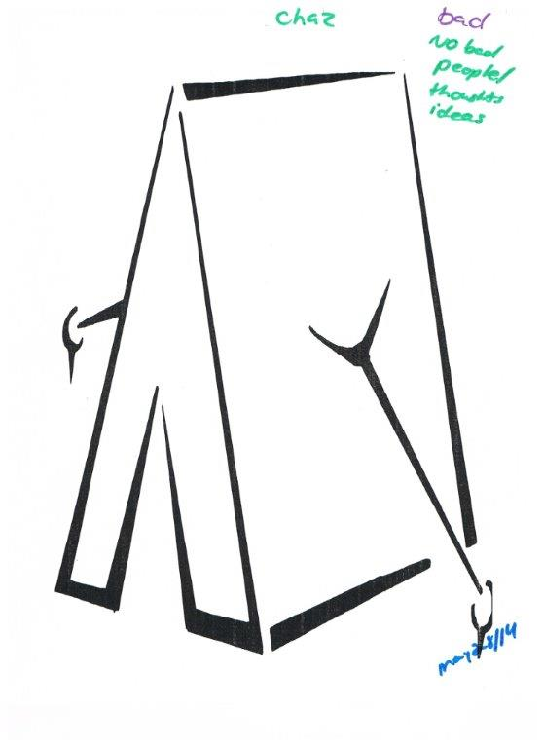
Marks’s three houses

Slide 10
Jack’s three houses
Notes:
Caseworker’s ongoing relationship with the boys allowed her to ensure she captured their voices through the questioning she asked them while they played, and spent time together. Due to their anxiety around anything new, caseworker shared how when she pulled the papers out to do the ‘three houses’ they knew this was going to be documented and shared. The actual paper versions of the three houses was not used until after our family mapping session. This was so we captured the children’s honesty as they are fearful of what will be written down and shared. What was interesting for the caseworker is how their answers changed. They didn’t have many worries in their pictures…they just wanted to be home with mom. It is important not to get hung up on using the “paper, concrete tools” of the three houses, but instead use the principles of building relationships with children to ensure their voices are heard in planning.

Slide 11
Billy’s Three Houses
Notes:
Caseworker’s ongoing relationship with the boys allowed her to ensure she captured their voices through the questioning she asked them while they played, and spent time together. Due to their anxiety around anything new, caseworker shared how when she pulled the papers out to do the ‘three houses’ they knew this was going to be documented and shared. The actual paper versions of the three houses was not used until after our family mapping session. This was so we captured the children’s honesty as they are fearful of what will be written down and shared. What was interesting for the caseworker is how their answers changed. They didn’t have many worries in their pictures…they just wanted to be home with mom. It is important not to get hung up on using the “paper, concrete tools” of the three houses, but instead use the principles of building relationships with children to ensure their voices are heard in planning.

Slide 12
Words and Pictures Explanation and Child Relevant Safety Plans
“Words and pictures” is a process for informing young children about child protection concerns and a safety planning method that both involves and directly speaks to children.
This is done without trivializing or minimizing the seriousness of the child protection concerns.
It gives everyone working with the child a common language when talking to the child
Notes:
even articulate “unsafe” that well.

Slide 13
Benefits of Words and Pictures for the Caregiver
Allows them to see the strengths of the family and can use positives from the story to build their relationship with the child and the family
Gives them a clear picture of the reason for the child’s placement and is tool they can use when the child has questions
Can help support reunification by discussing the safety plan with the child if they are expressing worries

Slide 14
Safety Planning in Signs of Safety
Safety is strengths demonstrated as protection over time.
Organizing a network (village) that surrounds the child with a common understanding of the concern and specific roles for protection.
A service plan or services are NOT a safety plan. A safety plan is a specific set of rules and arrangements that describe how the family will go about everyday life and show that the children will be safe.

Slide 15
You Might See Workers:
Taking more time to engage the family in both the information gathering and planning process
Encouraging participation from extended family, formal and informal supports who can contribute and be a part of the family’s safety plan
Focusing on the strengths of the family that support safety
Workers asking different types of questions geared more toward the strengths of a family

Slide 16
What do these shifts mean to caregiver?
You may be asked to support a family in a new and different way
You may be invited to a family meeting to participation in the ongoing safety planning for the children with their family
Actively participate and collaborate on the development of a service plan designed to achieve intended outcomes

Slide 17
What has worked well?
Families more engaged.
When parents are viewed as the experts it builds confidence and capacity in them to take ownership and implement THEIR plans.
Workers growing in confidence that children can be kept safe in the home.
We are challenging our assumptions and becoming more clear on what is harming the child and what is safe enough. Workers and families build a joint understanding of the concerns.
Assessment process is less reactive and considers everyone’s perspective.
Everyone is on the same page.
Shift from managing risk to building safety – reduces anxiety.

Slide 18
