Slide 1

Practice Strategies for Lifelong Connections
Children’s Services
2018
Notes:
This presentation will be discussed across Alberta, including various conferences.

Slide 2
A Stronger, Safer Tomorrow
Ministerial Panel on Child Intervention
Based on various engagements and deliberations, the panel delivered 26 recommendations aimed at strengthening the intervention system and addressing issues that help lead to children into receiving services
  Took written submissions and heard from all areas, including caregivers, across Alberta
Outlines 39 actions to improve services for Indigenous families, increase supports for children and youth, and add address the funding gap on reserve
The panel was supportive of the development of practice approaches and supports for families that were focused on safety, well-being, and connections
Notes:
The public action plan outlines a strategy for strengthening the child intervention system and better supporting children, youth and families. To address urgent needs, a number of specific actions will be implemented immediately, while work on all actions will be completed by 2022.

Slide 3
Practice Strategies for Lifelong Connections
Alberta created approach
Created with input from staff, caregivers, and stakeholders
  Round tables
  Representatives on committees
  Conferences
Align with leading research and data
Notes:
Practice strategies launched in 2014, and were initially focused on the “front end” – intake/assessment/initial status/placement decisions. The Practice Strategies for Lifelong Connections shift to a relationship based focus. We used leading research and evidence to inform their design. The development of the strategies was guided by staff, caregivers, and agency partners. This includes feedback from AFKA conferences, presentations, and representation on committees.

Slide 4
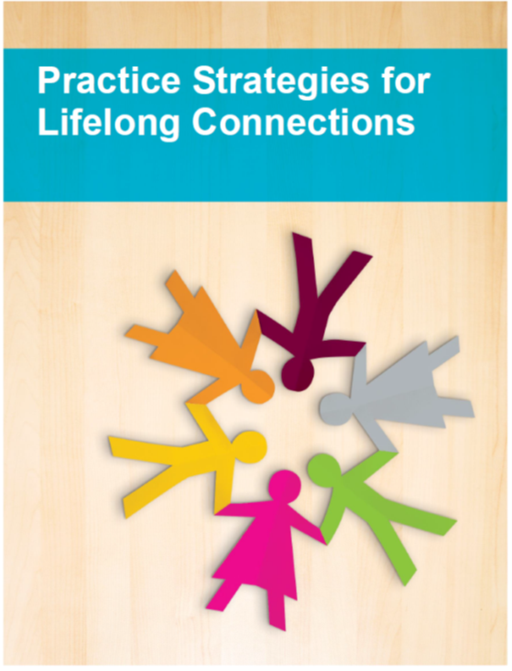
Practice Strategies for Lifelong Connections
10 practice strategies focusing on promoting safety, well-being, and connections, from intake to file closure
Supports critical thinking in decision making, creating and maintaining connections, and thoughtful transition planning.
Practice Strategies for Lifelong Connections is a principle-based practice approach under the Child Intervention Practice Framework.
Notes:
There were 6 original strategies, that were refreshed to reflect current practice. There are 4 additional strategies that were built over the past 3 years to support decisions once a file opens. This includes transitions between placements, and connections for kids, especially kids in-care.
The strategies are a blend of principles, philosophy, and explicit instructions for staff regarding decision making.

Slide 5
Practice Strategies for Lifelong
Connections – Philosophy
Further support the important work of identifying and maintaining connections for children and youth
Highlight importance of collaboration
Critical thinking specific to connections, community, and transitions for children and youth
To be used across the intervention spectrum – do not just apply to some work
Notes:
The philosophy emphasizes that connections for kids is critical, and collaboration between all involved with a family, child or youth. Staff will be required to consider all important relationships and how to maintain and build on them. This includes family, community, culture, and caregivers.
We must work together – especially because caregivers play a significant role as team members.

Slide 6
Four Areas of Connection
Shift in our language
No longer four areas of Permanency
  After thorough consultation, it was decided connection better reflects the intent of the work
Provincial definitions
  Created through thorough consultation with multiple sources and key area’s to provide feedback on.
  Create understanding across the spectrum of our services from intake to adoptions, front-line to the minister, and agency partners to caregivers.
  Provide consistency and reliability from all areas of service delivery.
Notes:
Language is shifting to reflect the philosophy – which means a move to connection.
Permanency is hard to define, as it means many things to many people, even within the child intervention system. It also has a negative meaning for indigenous communities – speaks to their “loss” of children in the past and the trauma related to those experiences.
This shift highlights a focus on long-term health and well-being for kids through stability and relationships.

Slide 7
Four Areas of Connection
Relational: An enduring connection to family, friends, caregivers and significant individuals that provide a sense of belonging, unconditional love, acceptance, and someone to rely on in times of need.
Physical: A place to call home that is stable, safe, and welcoming where a child or youth feels they truly belong.
Cultural: Participation and connection to one’s ancestral history- language, religion, customs, belief systems, social roles and celebrations and/or birth place that fosters a strong sense of identity, provides a higher self-esteem and self-worth .
Legal: A formally recognized family membership that provides legal security.
Notes:
These definitions are meant to be holistic and allow for space to develop plans unique to each child or youth.
Relational connection is meant to capture the relationships with significant people, and would include previous caregivers, siblings from previous placements, biological family, and the development of friendships with peers.
Physical captures the physical space where children and youth feel safe and where they are always welcome.
Cultural connections may include connecting an Indigenous youth with an Elder from their community, or connecting an LGBTQ2S+ youth to relevant community supports that allow them to develop a sense of belonging and identity.
Legal connection includes private guardianship or adoption for a child or youth.

Slide 8
What changes you will see
Consistency in practice being delivered across the province
Focus on connections from the beginning of involvement
Emphasis on connections throughout a child or youth’s time in-care
These practice shifts are consistent with leading practice, such as Family Finding and Signs of Safety
Supported by research, evidence from evaluations, and direct feedback from frontline, agency, caregivers, and families
Notes:
Consistency and connections are our main drivers. We want to deepen our use of principles and tools through explicit application.
Caregivers play a critical role in maintaining relationships for kids. This also includes understanding of connections to caregivers, which means transitions are better planned.
Team work is crucial – collaboration is at the forefront of practice.

Slide 9
What this means for children/youth
Creating and maintaining relationships for children and youth in-care
A holistic approach to connections
Building relationships for children and youth who have been previously disconnected
  Bio family
  Community
  Cultural, spiritual or religious leaders
Notes:
Children and youth will have a sense of continuity – in their relationships, connections, access to important people.
There is also a focus on identity and allowing children and youth the space, and supports, to develop a sense of self. They are better able to see their future, set goals, and be confident.
Working with connections and collaboration as main drivers results in less lonely children and youth who are able to develop a stronger sense of belonging and unconditional love.
For example, staff from across the Province, as well the Ministerial Panel that developed a Stronger Safer Tomorrow, listened to the story of a youth who aged out of care. She spoke of the loneliness she felt, and the absence of people in her life to help her develop life skills to take with her into adulthood. This young persons most significant relationship was with one of her previous workers. Although it highlights the good relationship that worker was able to build, she needed to have been provided more opportunities to stay connected to her family, her community, and previous caregivers so that she had a group of supportive individuals in her life to follow her into adulthood.

Slide 10
What is your role?
Caregivers are an essential part of the team
Facilitate connections for children and youth in your care to people that are important to them
Participate with and support the child/youth in their connection to cultural, religious and/or spiritual practices that honours their heritage
Notes:
Your role as an essential team member means sharing our focus on connection and collaboration.
Transitions will be better planned and require flexibility and time.

Slide 11
What is your role?
Creativity and flexibility in meeting the needs of families, children and youth
Transitions for children and youth are better planned, including how to maintain relationships with previous caregivers
More thoughtful planning means that transitions and other processes may require more time
Notes:
Your role as a key team member provides opportunity for better transition planning, and the ability for kids in care to maintain relationships with previous caregivers. You are a significant person in a child or youths life, which is not discounted.
Thoughtful planning and processes take time, we do not want to make decisions on a whim and without collaborative conversations occurring.

Slide 12
10 Strategies

Slide 13
Supervisor Consults
Staff are formally supported in decision making
Critical thinking
Slowing down processes
Notes:
This speaks to the formal process of getting approval for decisions and talking it through with a supervisor.
Supervisor consults must occur at various decision points throughout involvement with a family. Supervisors are the decision maker and their involvement and consultation is reinforced through policy.

Slide 14
3rd Person Consults
Expanding people in the room
Shared decision making
  Decisions are not made in a rush
Formal process that must be used at various points
  Placement moves
  Returning a child home
  Change in primary legal status
Previously called In-care consults
  Expanded use
Notes:
Also considered manager approval or involvement of a manager.
There are certain decision points where a 3rd person consult is required by policy – including a change in primary legal status, returning a child home or placement moves, and before a child is brought into care.

Slide 15
Family/Natural Supports Meetings
Involving family and network members early on
Caregivers included in planning
Planning is inclusive and creative in meeting the family, child/youth’s needs
Thoughtful and purposeful planning requires time
Also known as Case Conference or Service Team Meetings
Notes:
A Family/natural support meeting must occur prior to bringing a child/youth into care. If a child/youth comes into care via an emergency apprehension, the family/natural supports meeting must occur within 48 hours.

Slide 16
Immediate Kinship Placement, Ongoing Kinship Placement
Minimize trauma, maintain connections, and build on cultural and historical traditions
Kinship placement options are continuously explored
Collaboration with the kinship family and consistent engagement of the network, including previous caregivers
Notes:
Kinship placement options are pursued as the first option, whenever possible.

Slide 17
Family Time
Belief that children need to remain connected to their family, especially siblings
Creating and nurturing opportunities for connection beyond physical placement
Family time is crucial for ongoing connection and reunification
Previously known as Family Visits
Notes:
You may also hear the language of family visits to describe this strategy.
Caregivers play an important role in supporting the ongoing connection to family, through frequent access with family, siblings and any important connections identified by the child or youth. Caregivers support this connection in many unique ways, meeting at doctors appts, inviting family to important events at school or daycare, and even including family time in your home.

Slide 18
Cultural and Spiritual Connections
Children and youth of all cultures need to have a plan that thoroughly considers cultural and spiritual connection
  Maintain relationships that are important to them,
  Be connected to their own culture and,
  Practice their religious or spiritual beliefs
Culture and spirituality are represented in all planning
Notes:
Formally known as cultural plans.
This is about supporting relationships between kids and their heritage or culture. This includes work to bridge between caregivers and Bands/Nations, Designates, and communities.
Inclusion of cultural considerations when planning is critical to support and solidify connections to a child or youth’s culture, community and identity and will be reinforced throughout policy.

Slide 19
Formalized Connections
Focuses on guardianship being within a family context
Full family membership through reunification, adoption or guardianship
Important to the social development of children
Early planning is essential for all children and youth
Also known as adoptions/private guardianship – legal connection
Notes:
In most cases you hear this described as permanency or permanency planning. However, this extends beyond to be inclusive of connections and relationships and the role they play in decision making around formal or legal decisions.
Policy will require that a Sibling/Kinship Search Request is completed through the Post Adoption Registry if a child needs to come into care.

Slide 20
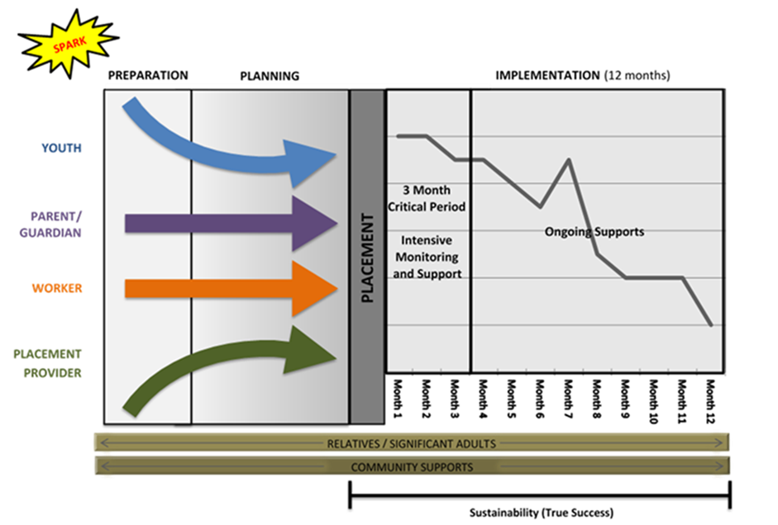
Terminating Permanent Guardianship Orders
Guides staff through reassessing the safety concerns
Provides a timeline that allows for thoughtful and purposeful planning
What might have put a child or youth at risk at one point in time may have shifted and no longer pose the same level of safety concerns
Reunification takes time
Notes:
Strategy outlines 6 steps and a minimum timeline of 12 months. This process will be required by workers when terminating a PGO as it will be in policy.

Slide 21
Transition to Adulthood
Ensuring a healthy transition to adulthood is the goal of every parent or guardian
Youth in care face unique challenges
  trauma
  loss and grief
  disconnection from family and community
  cultural isolation
Supports interdependence, connections, and planning for a successful future
Notes:
Kids in-care should have the opportunity to establish supportive connections that will follow them into their adulthood. Youth transition successfully into adulthood when they have healthy relationships with their family and community, are developmentally well understood, and have had opportunities to build life skills. This transition requires purposeful and thoughtful planning with the youth themselves and the people in their lives.
Some youth will require services into their adulthood to ensure their needs are met. This transition is done collaboratively according to the existing protocol with adult disability service programs to ensure seamless services delivery and continuity of services. This includes work with the Office of the Public Guardian and Trustee when adults require a guardian appointed by the court to support them in their care and making of personal decisions.
Although not all youth be will eligible for additional support as they become adults, a focus on connections and building a network of supportive individuals around a youth will support them in their transition to adulthood.

Slide 22
Is there policy changes?
Yes, and plans will be updated to reflect these changes
Notes:
Policy changes mean that these will be musts for staff across child intervention.
Actions to support connections must be a part of all planning conversations and incorporated into planning at all stages. Plan documents are shifting to incorporate the 4 areas of connection - relational, cultural, physical and legal. These will prompt the conversations for lifelong connection planning.
Policy changes that support these practice shifts will be released in late Fall 2018.

Slide 23

Questions?

